Slide 1
Silent Speech Recognition : Automatic Lip reading Model using 3D CNN and GRU
Lip reading, the ability to understand spoken language by observing lip movements, is an essential skill for individuals with hearing impairments and in scenarios where audio information is compromised. Automatic lip reading systems, powered by deep learning techniques, have shown promising results in converting lip movements into text. This project proposes an advanced lip reading model that combines 3D Convolutional Neural Networks (CNNs) and Gated Recurrent Units (GRUs) to improve the accuracy and robustness of lip reading.
In visual speech recognition (VSR), speech is transcribed using only visual information to interpret tongue and teeth movements. Recently, deep learning has shown outstanding performance in VSR, with accuracy exceeding that of lipreaders on benchmark datasets. However, several problems still exist when using VSR systems. A major challenge is the distinction of words with similar pronunciation, called homophones; these lead to word ambiguity. Another technical limitation of traditional VSR systems is that visual information does not provide sufficient data for learning words such as “a”, “an”, “eight”, and “bin” because their lengths are shorter than 0.02 s. This report proposes a novel lipreading architecture that combines three different convolutional neural networks (CNNs; a 3D CNN, a densely connected 3D CNN, and a multi-layer feature fusion 3D CNN), which are followed by a two-layer bi-directional gated recurrent unit. The entire network was trained using connectionist temporal classification. The results of the standard automatic speech recognition evaluation metrics show that the proposed architecture reduced the character and word error rates of the baseline model by 5.681% and 11.282%, respectively, for the unseen-speaker dataset. Our proposed architecture exhibits improved performance even when visual ambiguity arises, thereby increasing VSR reliability for practical applications.

Slide 2
By using the following steps and procedure we can solve the challenge:
The proposed solution for the challenge of silent speech recognition involves the development of an lip reading model using a combination of 3D Convolutional Neural Networks (CNNs) and Gated Recurrent Units (GRUs). The idea consists of the following key steps:
Data Collection and Preprocessing: Gather a diverse dataset of video sequences where individuals speak, and their lip movements are clearly visible. This dataset will be used for training and testing the model. The videos will undergo preprocessing to extract frames and associated textual transcriptions.
Feature Extraction with 3D CNNs: Implement a 3D CNN architecture to capture the spatio-temporal features of lip movements. Unlike traditional 2D CNNs that process images, 3D CNNs work with sequential frames of video. This allows the model to learn both spatial patterns (lip shapes) and temporal dynamics (changes over time) from the lip movement sequences.
Temporal Sequence Learning with GRUs: Integrate Gated Recurrent Units (GRUs) into the model to capture long-term dependencies and temporal relationships between sequential lip movement frames. GRUs are a type of recurrent neural network (RNN) that are capable of learning patterns over time, which is crucial for interpreting speech from lip movements.
Model Training and Optimization: Train the combined 3D CNN-GRU model using the preprocessed dataset. During training, the model learns to map lip movement sequences to corresponding transcriptions. Optimization techniques such as gradient descent and backpropagation will be employed to fine-tune the model's weights and biases.
Evaluation and Fine-tuning: Assess the model's performance on a separate validation dataset. Metrics such as accuracy, precision, recall, and F1-score will be used to measure how well the model converts lip movements into accurate text predictions. Fine-tuning of hyperparameters and model architecture adjustments can be performed based on the evaluation results.
Deployment and Integration: Once the model achieves satisfactory performance, deploy it as part of a real-time silent speech recognition system. This system can take in video input, process it through the trained model, and produce text transcriptions of the spoken content. Integration with existing communication technologies or applications can be considered for wider usability.

Slide 3
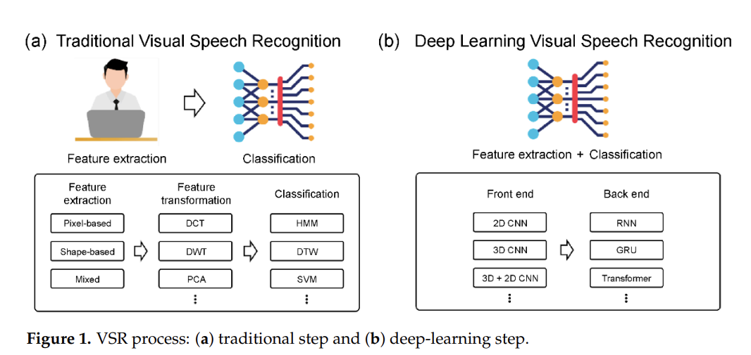

Slide 4
NOVELTY/UNIQUENESS:
The novelty/uniqueness developed by our team is the architecture and the network in the silent speech recognition.
Architecture:
This section describes a VSR deep learning architecture and proposes a novel visual feature extraction module .The proposed module is compared with other visual feature extraction modules that exhibit outstanding feature extraction performance:(i) LipNet as the baseline module (ii) four other comparative architectures with different visual feature extraction modules, namely, 3D LeNet-5, 3D VGG-F, 3D ResNet- 50, and 3D DenseNet-121.provide the detailed hyperparameters describing the proposed architecture
Spatial-Temporal CNN:
CNNs directly use raw input data, thereby automating the feature construction process. When a 2D CNN is applied to an image recognition task, it captures the encoded information for a single image’s data and then transfers the encoded information to compute features from the spatial dimensions using 2D feature maps. However, the application of a 2D CNN to a video identification task, where the motion information is encoded in multiple contiguous frames, is ineffective. Therefore, we use a 3D CNN, which acts as a spatial-temporal CNN in the convolution process, to compute features of both the spatial and temporal dimensions and to capture different lipreading actuations, such as the movements of the lips, tongue, and teeth. This use of a 3D CNN is supported by studies that have shown that 3D CNNs are effective for the extraction of features from video frames, when spatial and temporal information encoded in subsequent frames. Detailed architecture: (a) baseline and (b) proposed architecture. By transforming a single video frame into a cube by stacking several consecutive frames together, the spatial-temporal convolution uses a 3D kernel. In this construction ,the feature maps of the convolutional layer are bound to several consecutive frames of the previous layer, which makes it possible to collect motion information during video analysis.Formally, tan h(_) is the hyperbolic tangent function, bij is the bias for this feature map, Riis the size of the 3D kernel along the temporal dimension, wpqr ijm is the (p, q, r)th value of thekernel linked to the mth feature map in the previous layer, and the value at position (x, y, z) on the jth feature map in the ith layer is given.
3D Densely Connected CNN:
A densely connected CNN creates relationships between various layers of the connection, which helps enable full use of the features, reduces the gradient disappearance problem, and deepens the network. Before the convolution layer, the bottleneck layer reduces the input feature volumes. The multichannel feature volumes are then fused following the bottleneck layer process. As the preceding features remain, the next layer is only applied to a small set of feature volumes. In addition, with the hyperparameter theta regulating the degree of compression, transition layers are included to improve the model compactness further. Adopting a bottleneck layer, transition layer, and smaller growth rate results in a narrower network. This strategy reduces the model parameters, effectively suppresses overfitting, and saves computational power. Although many researchers have used 2D CNNs and extracted visual information separately 3D densely connected CNNs were used by adding temporal dimensions to densely connected convolution kernel and pooling layers. This approach was used because 2D CNNs often require complex pre-processing and post-processing to perform the same tasks. Therefore, we modified the 2D DenseNet-121 architecture into a 3D DenseNet- 121 architecture to 35 maintain dense connectivity to enable deep feature extraction, and this architecture fully utilizes the information provided by the spatial-temporal CNN simultaneously. The dense block is a primary structure composed of densely connected composite functions in the 3D DenseNet-121 architecture, consisting of three sequential operations: BN, ReLU, and 3D convolution layers. The transition layers between different dense blocks contain a BN, ReLU, 3D convolution layer, and average 3D pooling layer.

Slide 5
MLFF 3D CNN:
Currently, outstanding performance has been achieved for image classification problems using different CNN models. An example is the fusing of multiple CNNs for feature aggregation, where extracting various spatial and temporal features is possible by creating different structures and depths Different convolutional layers can extract features at various levels of abstraction for the MLFF 3D CNN training phase. Various features can also be derived from this training process with varying depths and filters of different sizes. Using this approach, some of the related features lost in the layered architecture can be selected, rendering the final feature richer. The proposed MLFF 3D CNN architecture.The first module consists of a 3D convolutional layer with 64 3D kernels of size 3 × 5 × 5 on a 3D densely connected convolution layer output feature, followed by a BN layer and ReLU layer. For the second module , the structure of the first module is followed by a dropout layer to alleviate overfitting as the benchmark dataset used is not large compared with existing image datasets. The role of the dropout layer is to improve and generalize the performance by preventing the creation of strongly correlated activations, which solves overtraining and overfitting .In the third module, the structure is similar to that of the second module, except that the dropout layer is replaced by a spatial dropout layer , which is a method of dropping the entire feature map. Unlike the standard dropout method, which randomly drops pixels, this method exhibits excellent image Sensors 2022, 22, 72 8 of 20 classification using CNN models with strong spatial correlation Therefore, we applied a spatial dropout layer to effectively extract the she lips, teeth, and tongue with a strong spatial correlation that includes fine movements.
GRU:(Gated Recurrent Units):
The GRU is a recurrent neural network that learns to propagate and regulate the flow of information over more time stages [33]. The GRU can distinguish longer temporal contexts, which is helpful for discriminating ambiguity because 3D CNN captures only short viseme-level features. Moreover, the gradient vanishing problem can be solved by using a GRU, which uses an update gate and reset gate. Our proposed architecture uses a two-layer bi-directional GRU as a sequence processing module Unlike the typical deployment of GRU, a two-layer bi-directional GRU is employed to present information in both forward and backward manners to two separate neural network architectures that are connected to the same output layer, such that both networks can obtain complete information regarding the input. The two-layer bi-directional GRU layer receives its input from the MLFF 3D CNN sequentially and then generates characters as output, as follows
2.xl = Hl([x0, x1, . . . , x1−1])3.zt= σ(Wz at + Uzht−1 + bz)4. rt= σ(Wrat + Urht−1 + br)
5.ht= (1 − zt) ◦ ht−1+zt ◦ σr(What + Uh(rt ◦ ht−1) + bh
The GRU consists of four components (xt , zt , rt , and ht) and a given sequence of image features a = (a1, a2, · · · , at). xt is an input vector with its resulting weight parameter matrix and vector. zt is an update gate vector with its resulting weight parameter matrix and vectors Wz, Uz, and bz. rt is a reset gate vector with its resulting weight parameter matrix and vectors Wr , Ur , and br . Finally, ht is an output vector with its resulting weight parameter matrix and vectors Wh , Uh , and bh . ht−1 is the previously hidden state output, which has the same structure as the current state. σ is the ReLU function, used as an activation function. represents the Hadamard product. To obtain an output with 75 × 512 tensors using the merge layer, we provided an input sequence of 75 × 3 × 1 × 192 (time/width/height/channel) frames in a bi-directional GRU.

Slide 6
NETWORK:
The LipType network consists of two sub-modules (or sub-networks): a spatiotemporal feature extraction frontend that takes a sequence of video frames and outputs one feature vector per frame and a sequence modeling module that inputs the sequence of per-frame feature vectors and outputs .
Spatiotemporal Feature Extraction:
It starts with the extraction of a mouth-centred cropped image of size H:100 × W:50 pixels per video frame. For this, videos are first pre-processed using DLib face detector and the iBug face landmark predictor with 68 facial landmarks combined with Kalman Filtering. Then, a mouth-centred cropped image is extracted by applying affine transformations. The sequence of T mouth-cropped frames are then passed to 3D-CNN, with a kernel dimension of T:5 × W:7 × H:7, followed by Batch Normalization (BN) and Rectified Linear Units (ReLU) . The extracted feature maps are then passed through 34-layer 2D SE-ResNet that gradually decreases the spatial dimensions with depth, until the feature becomes a single dimensional tensor per time step.
Sequence Modeling:
The extracted features are processed by 2-Bidirectional Gated Recurrent Units (Bi-GRUs) .Each time-step of the GRU output is processed by a linear layer, followed by a softmax layer over the vocabulary, then an end-to-end model is trained with connectionist temporal classification (CTC) loss .The softmax output is decoded with a left-to-right beam search using Stanford-CTC's decoder and 5-gram character language model to recognize the spoken utterances. The model is capable of mapping variable-length video sequences to text sequences.Silent Speech Recognition, often referred to as automatic lip reading, has the potential to create significant business and social impacts. This technology involves using machine learning algorithms, such as 3D Convolutional Neural Networks (CNNs) and Gated Recurrent Units (GRUs), to convert visual lip movements into meaningful speech. Here's how it can have both business and social implications

Slide 7
ADVANTAGES:
Accessibility Services: Silent speech recognition can enhance accessibility for individuals who are deaf or hard of hearing. Businesses can integrate this technology into their communication systems, enabling seamless interaction between hearing-impaired individuals and others in various contexts, such as customer service, meetings, and presentations.
Market Expansion: Companies that adopt this technology can tap into a previously underserved market segment – people with hearing disabilities. This can lead to increased customer loyalty and a competitive advantage over businesses that do not offer such inclusive features.
Product Innovation: Tech companies can develop new products and services based on silent speech recognition. For instance, creating assistive devices like smart glasses that provide real-time captions or translating spoken language into sign language for improved communication.

Slide 8
Inclusivity: The most significant social impact of silent speech recognition is its contribution to inclusivity. It empowers individuals who are deaf or have hearing impairments to engage fully in conversations and activities that rely on verbal communication.
Education: In educational settings, this technology can transform the learning experience for students with hearing disabilities. Teachers can deliver lectures, and students can participate in discussions without barriers.
Employment Opportunities: Improved communication for individuals with hearing disabilities can increase their participation in the workforce. They can excel in roles that involve team collaboration, customer interaction, and public speaking.
Social Interaction: People with hearing disabilities can have more natural and immersive interactions with friends, family, and colleagues, fostering stronger relationships and reducing social isolation.
Advancing Research: The development of advanced machine learning models for silent speech recognition can also contribute to research in linguistics, cognitive science, and neuroscience, deepening our understanding of speech production and perception.

Slide 10
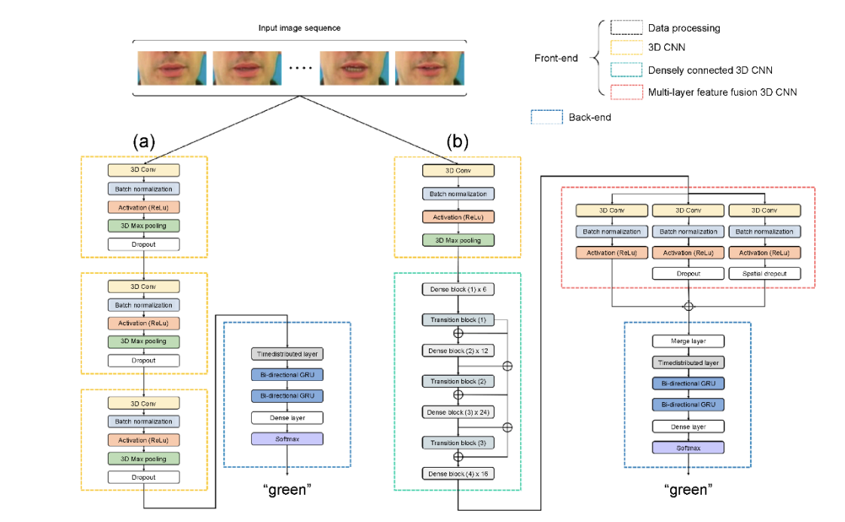
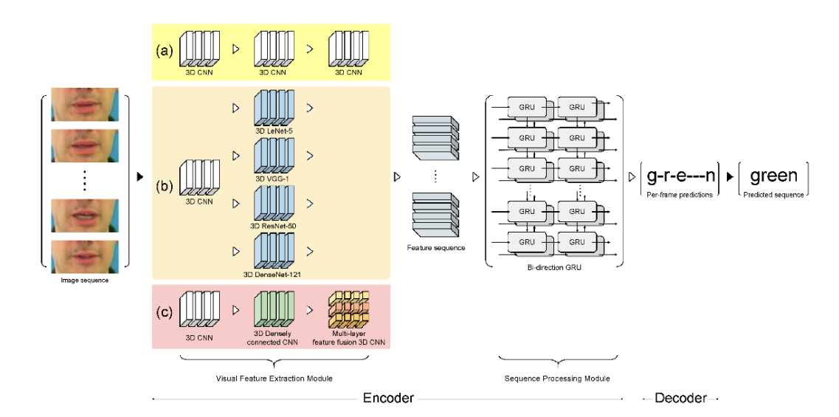
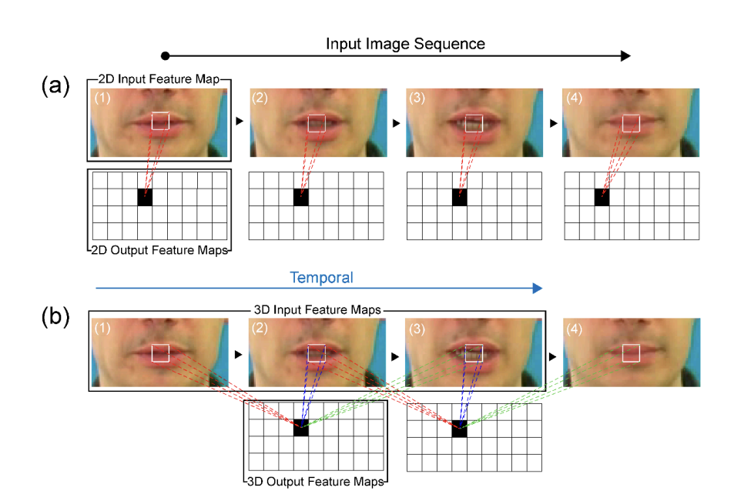

Slide 11
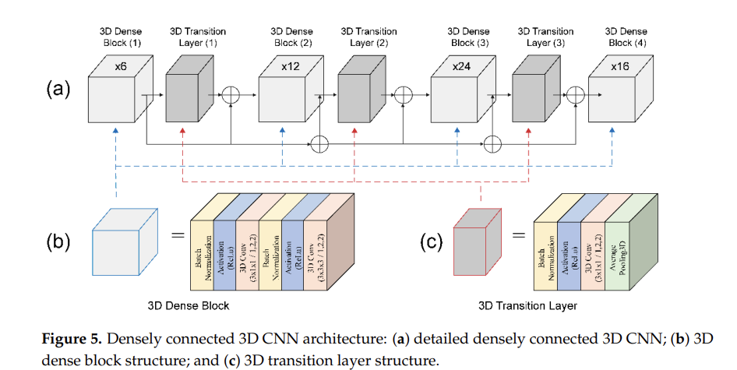
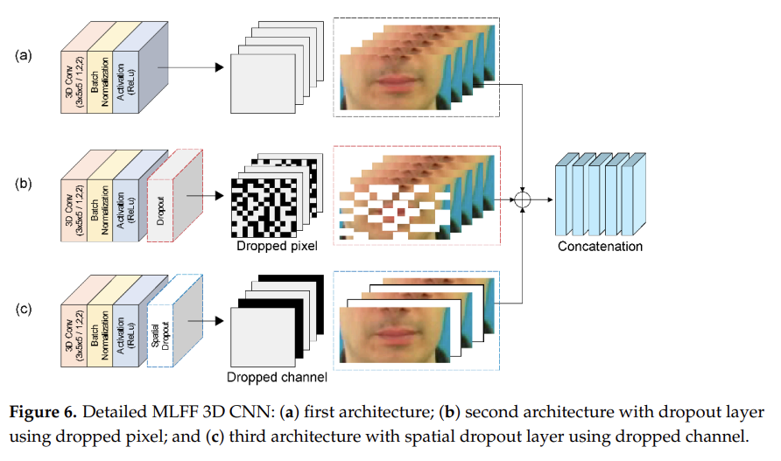

Slide 12
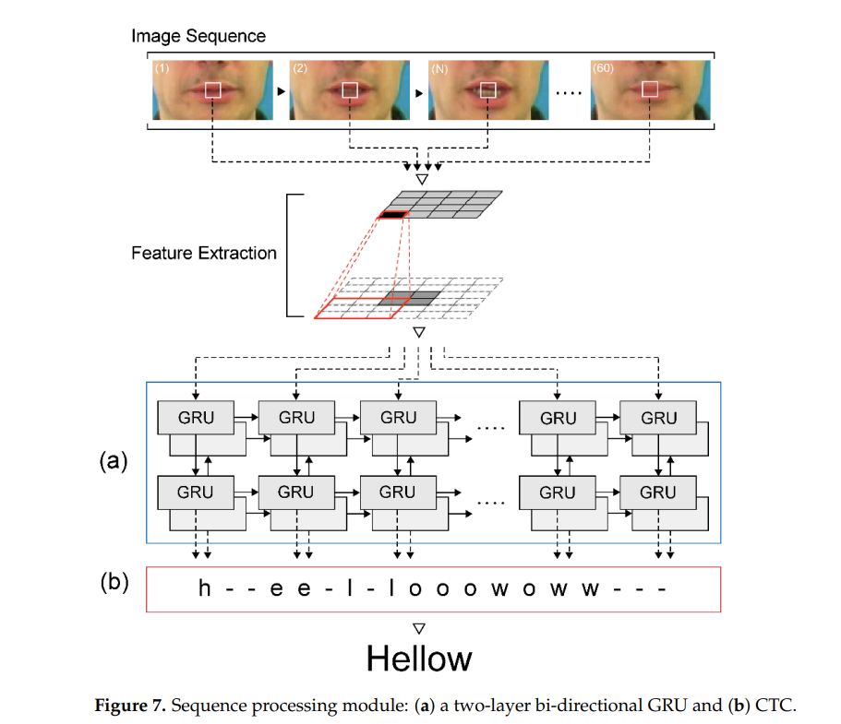

Slide 13
CONCLUSION:
This is the solution developed to problem statement silent speech recognition.

Slide 14
THANK YOU

